Slide 1
View Translation: Geometry-Guided Latent Diffusion for Cross-View Image Synthesis on Ground Vehicles
Omkar Mayekar¹, Mary Aiyetigbo¹, Ameya Salvi², Tanmay Samak², Chinmay Samak², Brendan Desjardins¹, Jonathon Smereka³, Mark Brudnak³, Venkat Krovi², Feng Luo¹, Nianyi Li¹
¹ Clemson University
² CU-ICAR
³ US Army DEVCOM GVSC
DISTRIBUTION STATEMENT A.
Approved for public release; distribution is unlimited. OPSEC10983

Slide 2
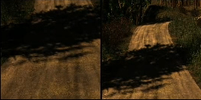
Motivation
Maintaining navigation using synthesized views from other camera sensor(s) is crucial for autonomous vehicles in case of failure.
Deep learning methods for view synthesis often struggle in off road settings due to changes in lighting condition, low-visibility and uneven terrain.
Front Camera
Rear Camera

Slide 3
Objectives
This paper focuses on developing a generative AI framework for novel view synthesis in off-road environments.
The goal is to reconstruct views between front and rear vehicle-mounted cameras by leveraging a diffusion-based framework.

Slide 4
Research Questions
How can integration of camera pose in model provide robust and effective view synthesis?
Can integrating pretrained depth estimators improve geometric consistency in off-road settings?
How can the proposed framework generalize across diverse environmental conditions, such as low visibility, uneven terrain, and abrupt view changes?

Slide 5
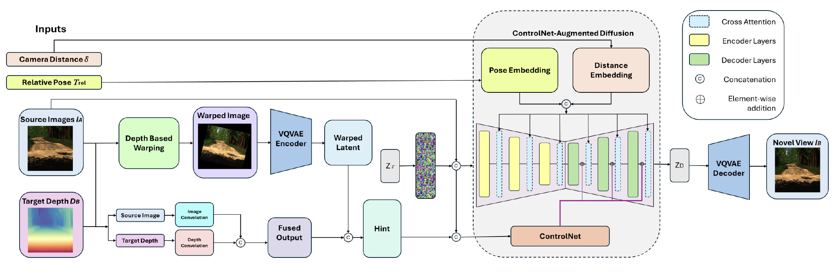
Our Approach

Slide 6
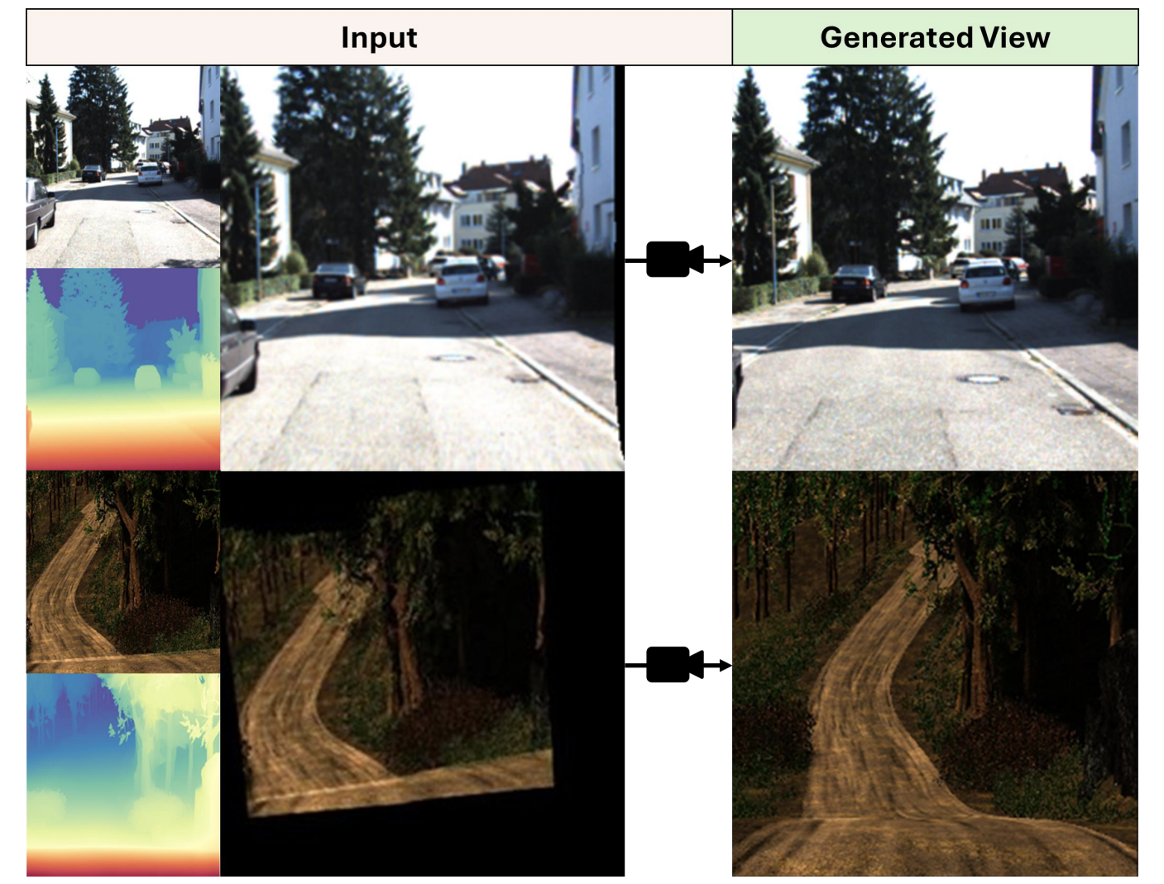
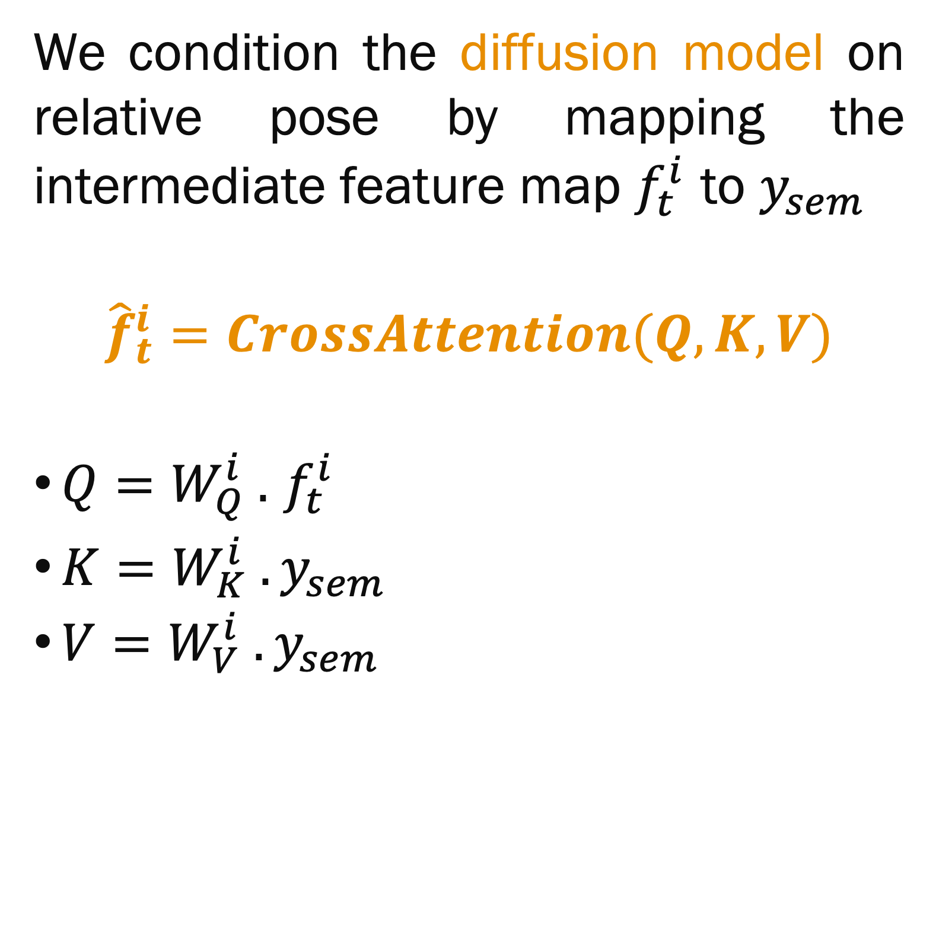

Pose and Image Conditioning
Given:
Source image $I_{s}$
Camera poses $c_{s}$, $c_{t}$
Relative pose $c_{r}= c_{s}^{−1}@ c_{t}$
Pose Condition $y_{sem}=[I_{s}, c_{r}]$
We condition the diffusion model on relative pose by mapping the intermediate feature map $f_{t}^{i}$ to $y_{sem}$
$${\hat{f}}_{t}^{i}=CrossAttention(Q,K,V)$$
${Q=W}_{Q}^{i} .$ $f_{t}^{i}$
${K=W}_{K}^{i} .y_{sem}$
${V=W}_{V}^{i} .y_{sem}$

Slide 7
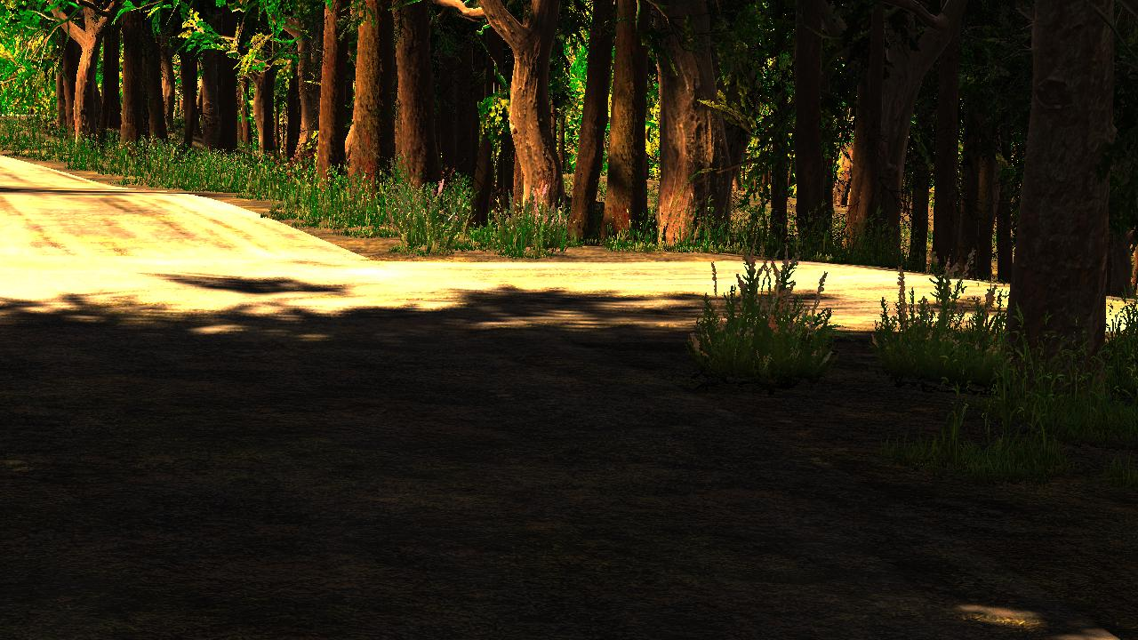


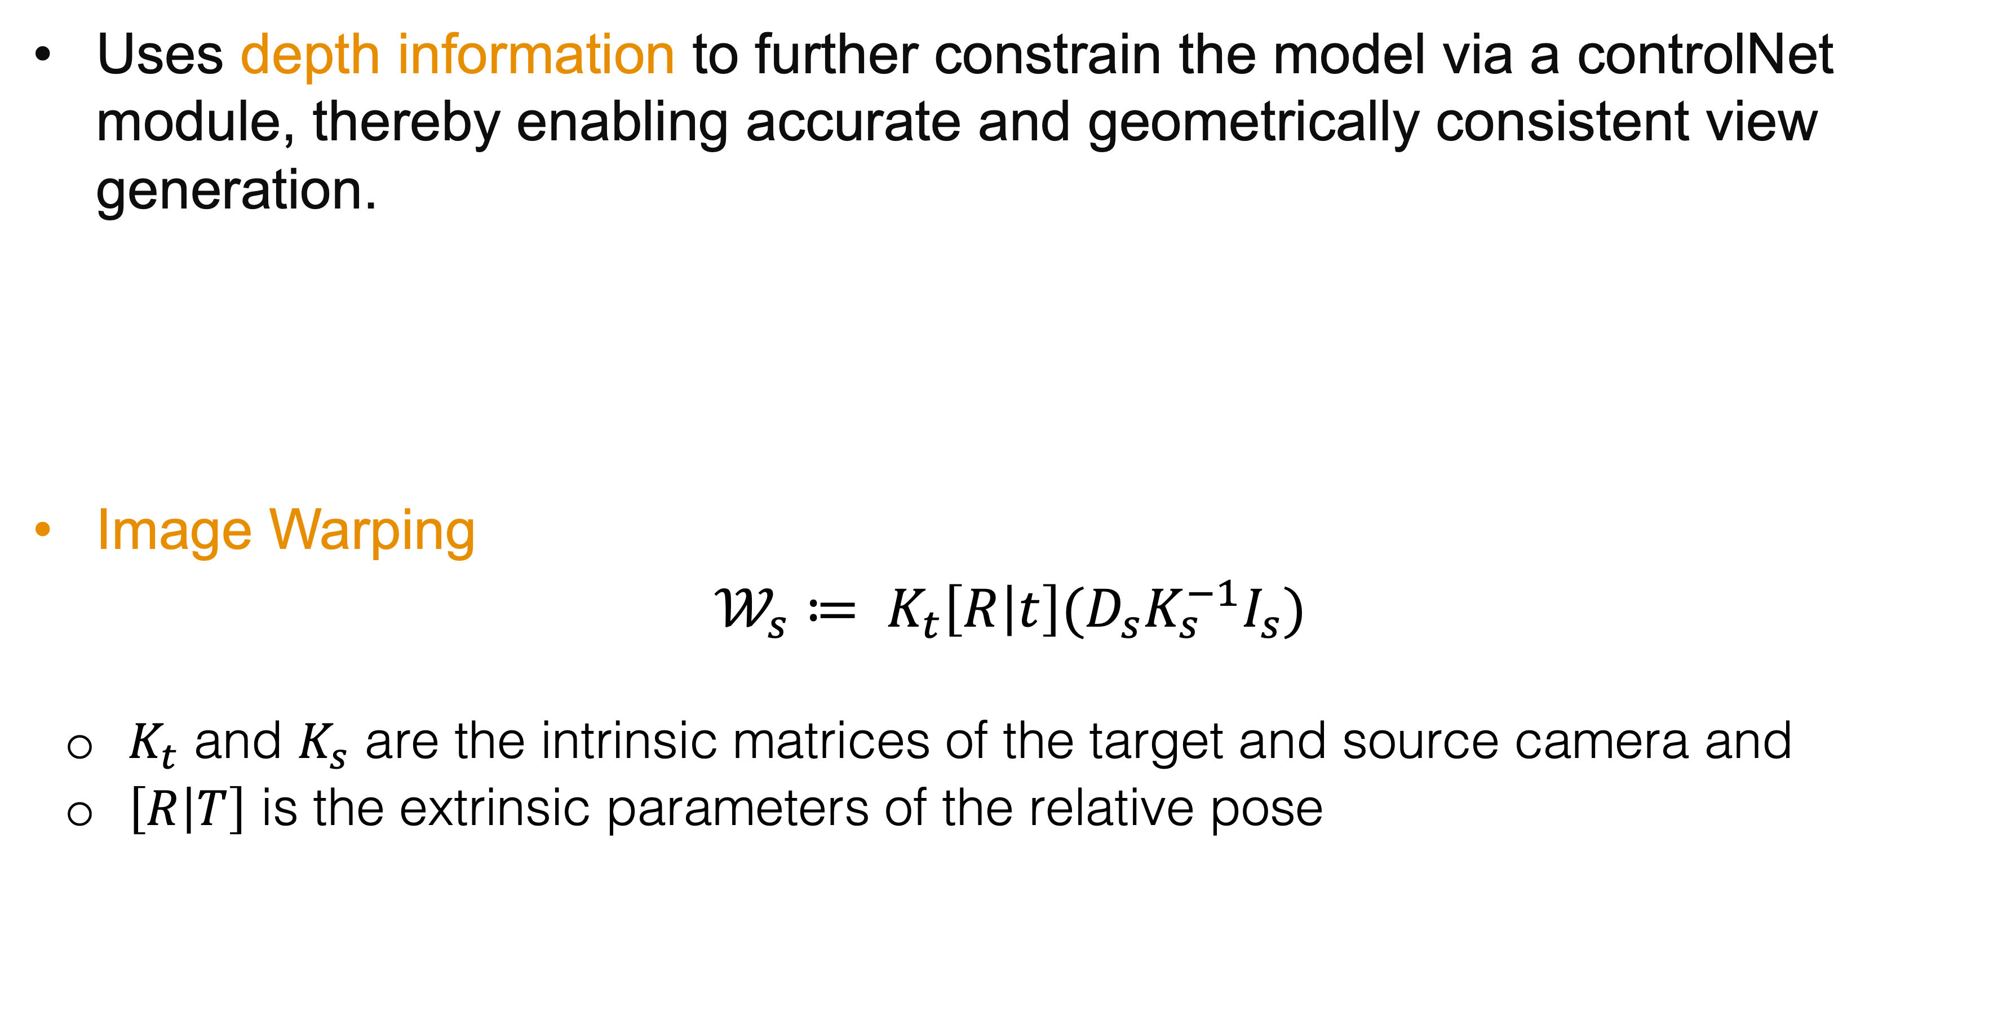


Depth-Aware Integration
Uses depth information to further constrain the model via a controlNet module, thereby enabling accurate and geometrically consistent view generation.
Image Warping
$𝒲_{s}≔ K_{t}\left[R | t\right]{(D}_{s}K_{s}^{−1}I_{s})$
          $K_{t}$​ and $K_{s}$ are the intrinsic matrices of the target and source camera and
          $\left[R | T\right]$ is the extrinsic parameters of the relative pose
$$φ$$
Pretrained Depth Estimator
(Depth Anything V2)
$$I_{s}$$
$$D_{s}$$

Slide 8
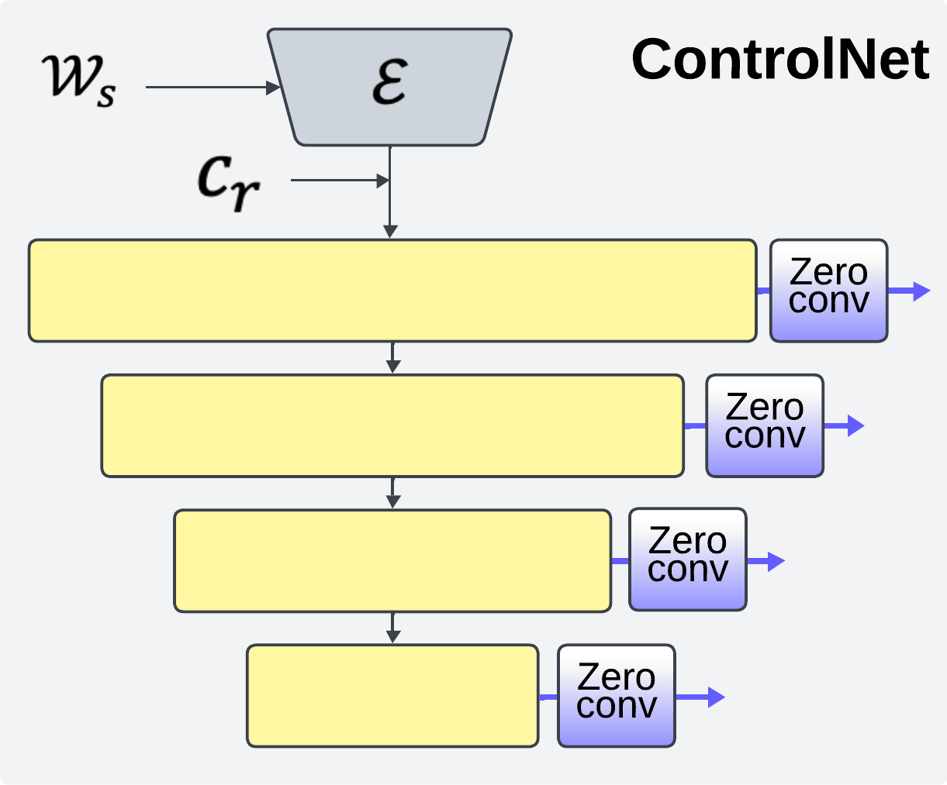
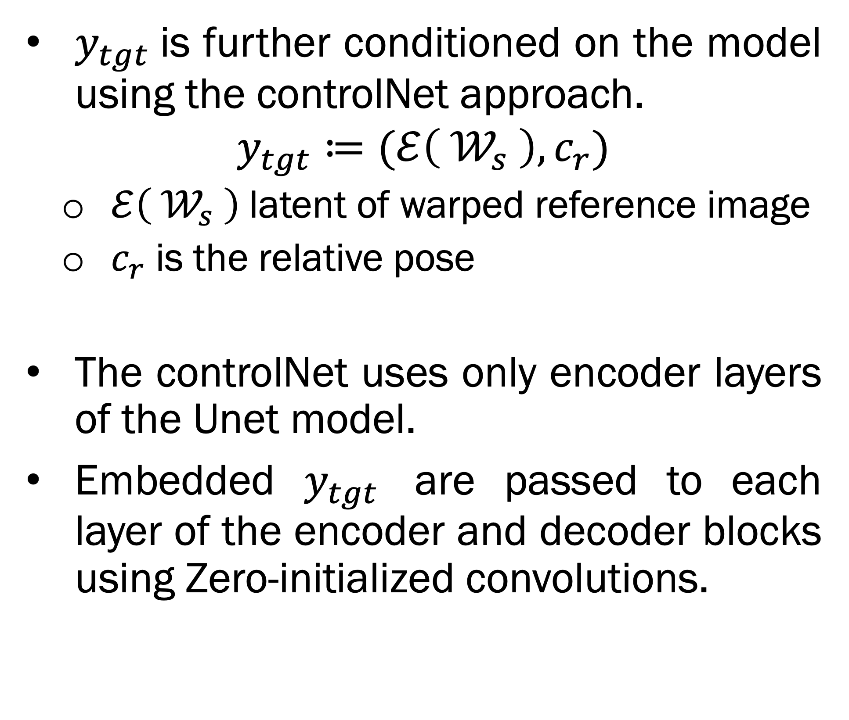
ControlNet Integration
$y_{tgt}$is further conditioned on the model using the controlNet approach.
$$y_{tgt}≔(ℰ\left({ 𝒲}_{s} \right),c_{r})$$
$ℰ\left({ 𝒲}_{s} \right)$latent of warped reference image
$c_{r}$is the relative pose
The controlNet uses only encoder layers of the Unet model.
Embedded $y_{tgt}$ are passed to each layer of the encoder and decoder blocks using Zero-initialized convolutions.

Slide 9
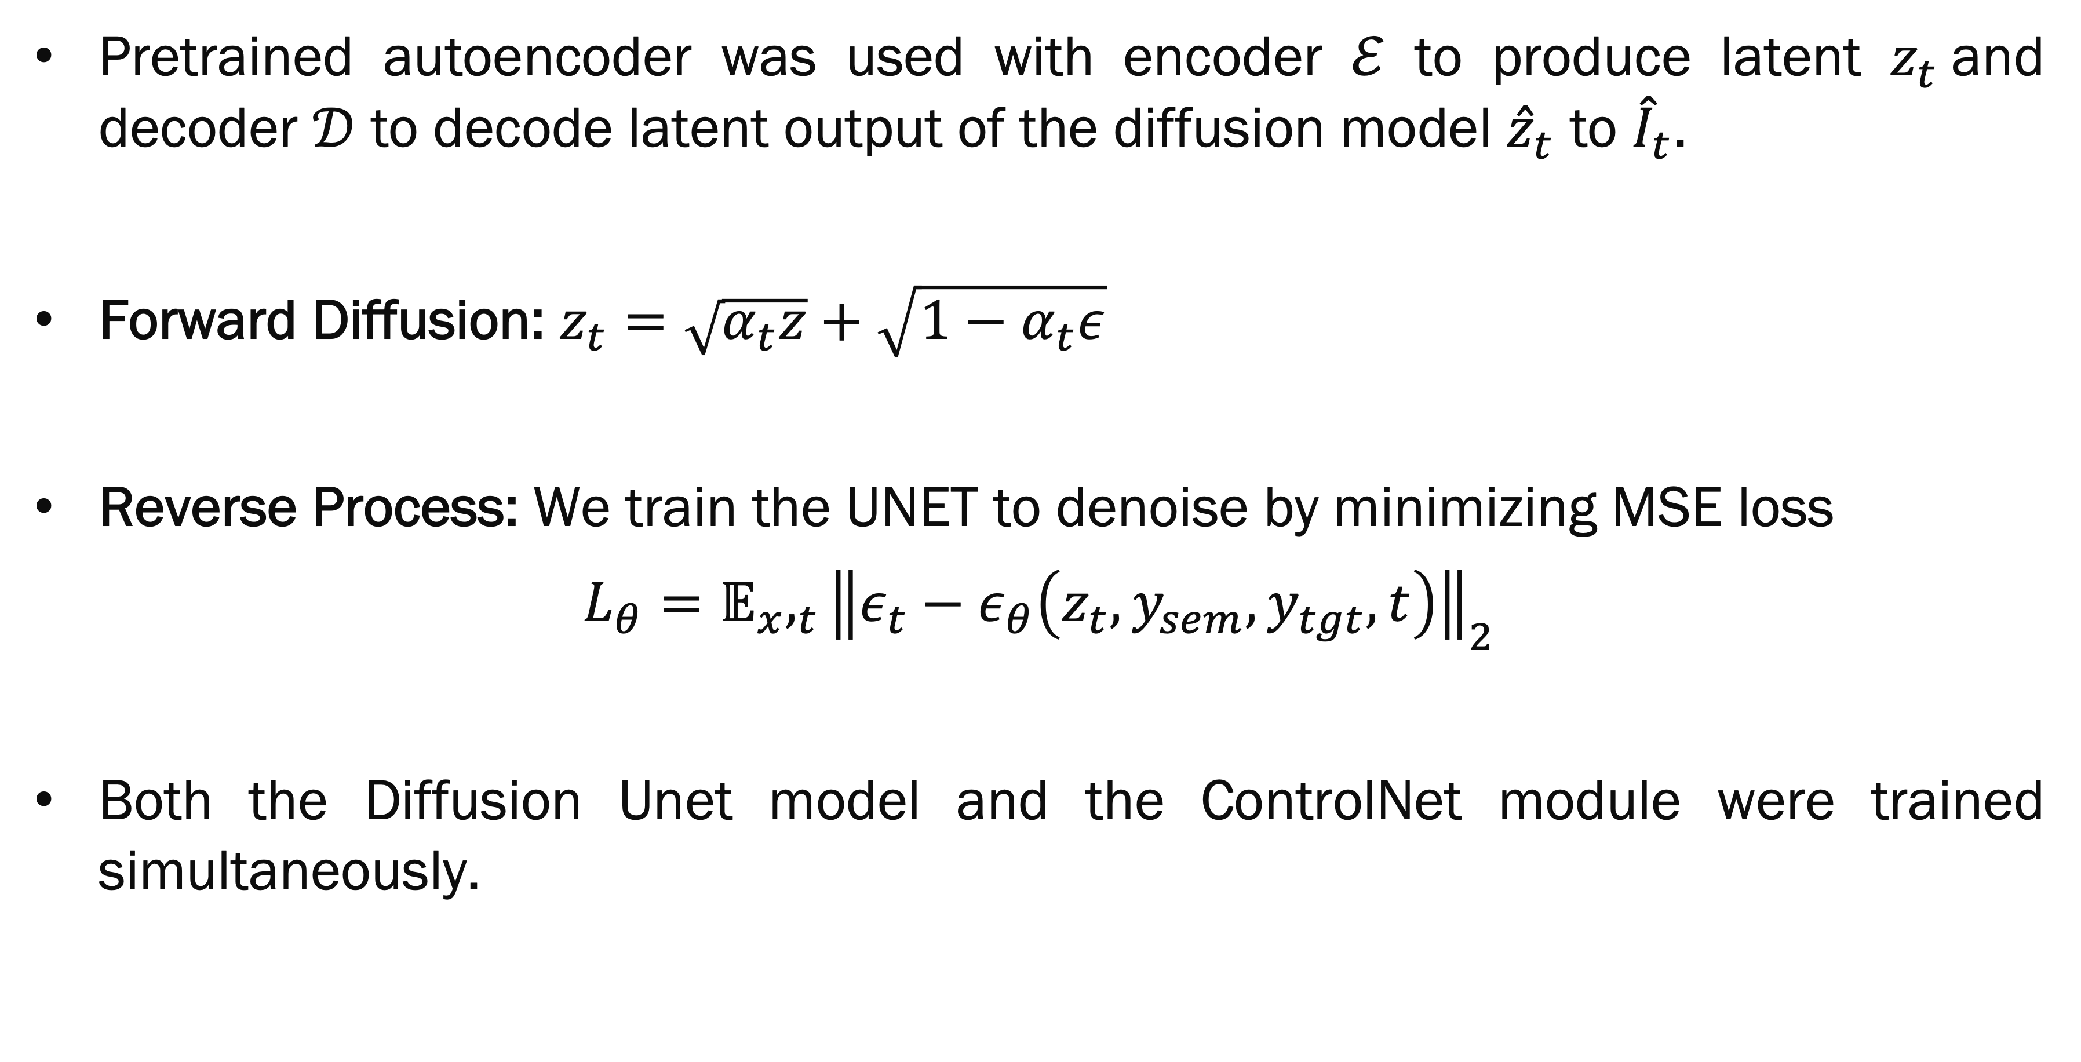
Training
Pretrained autoencoder was used with encoder $ℰ$ to produce latent $z_{t}$and decoder $𝒟$ to decode latent output of the diffusion model ${\hat{z}}_{t}$ to ${\hat{I}}_{t}$.
Forward Diffusion: $z_{t}=\sqrt{α_{t}z}+\sqrt{{1−α}_{t}ε}$
Reverse Process: We train the UNET to denoise by minimizing MSE loss
$${L_{θ}=𝔼}_{x},_{t}{\left\|ε_{t}−ε_{θ}\left(z_{t}, y_{sem}, y_{tgt}, t\right)\right\|}_{2}$$
Both the Diffusion Unet model and the ControlNet module were trained simultaneously.

Slide 10
Evaluation
KITTI Odometry
Simulated Off-Road
Urban driving
AutoDRIVE Simulator
• 256 × 256 images
• Source–target offsets: train {1,2,3}; test 4
• Target depth prior supplied during training and evaluation
• 2,468 synchronized left–right frames
• Repeatable multi-camera conditions
• Target depth prior supplied during training and evaluation
Metrics: FID ↓ measures distributional similarity · LPIPS ↓ measures perceptual difference · PSNR ↑ measures reconstruction fidelity

Slide 11
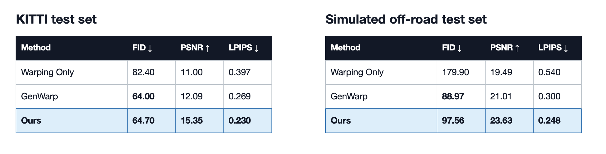
Our method delivers the strongest perceptual fidelity
Lower FID / LPIPS is better; higher PSNR is better. Values are reported from the final paper.
Across both datasets, View Translation has the best LPIPS and PSNR; GenWarp has the best FID.

Slide 12
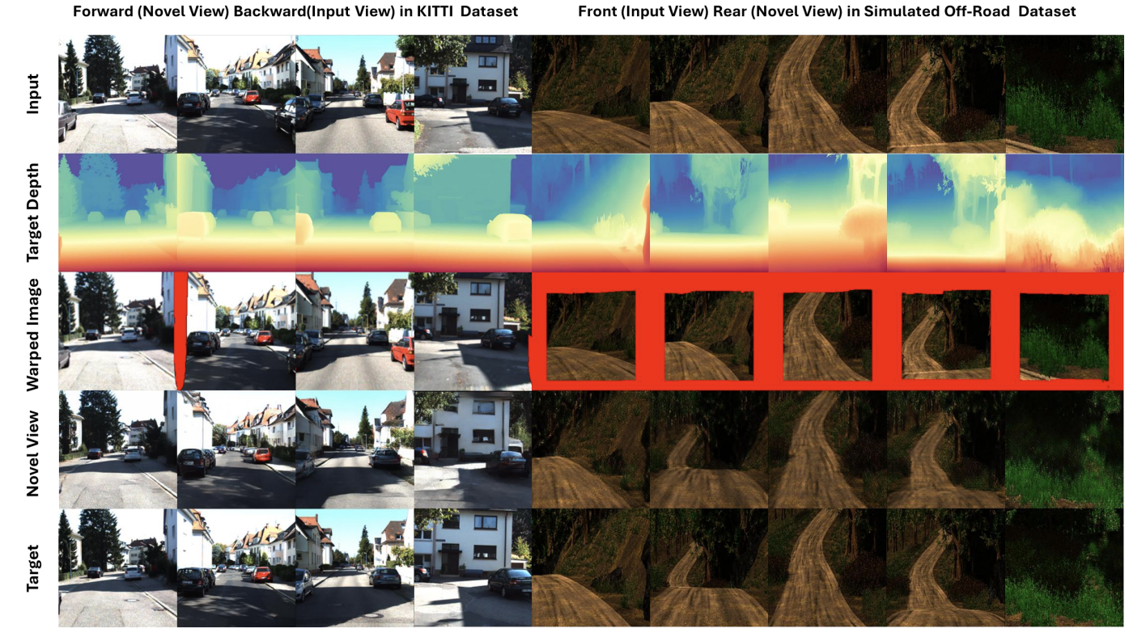
Qualitative Results

Slide 13
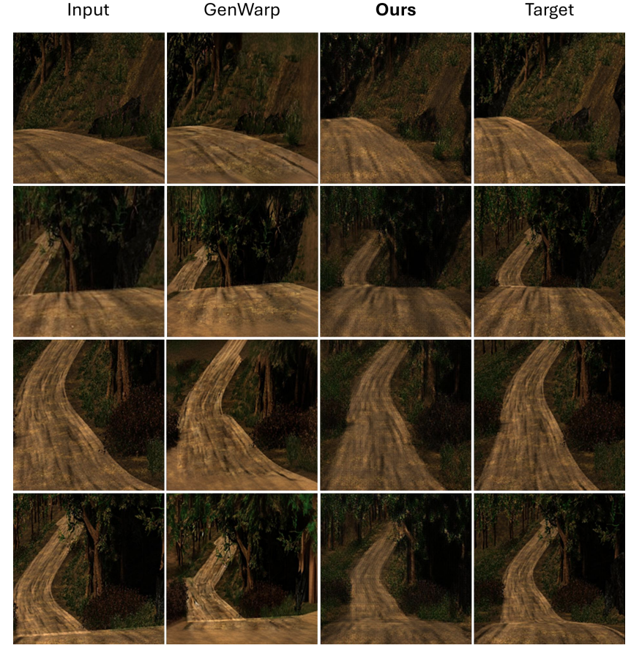
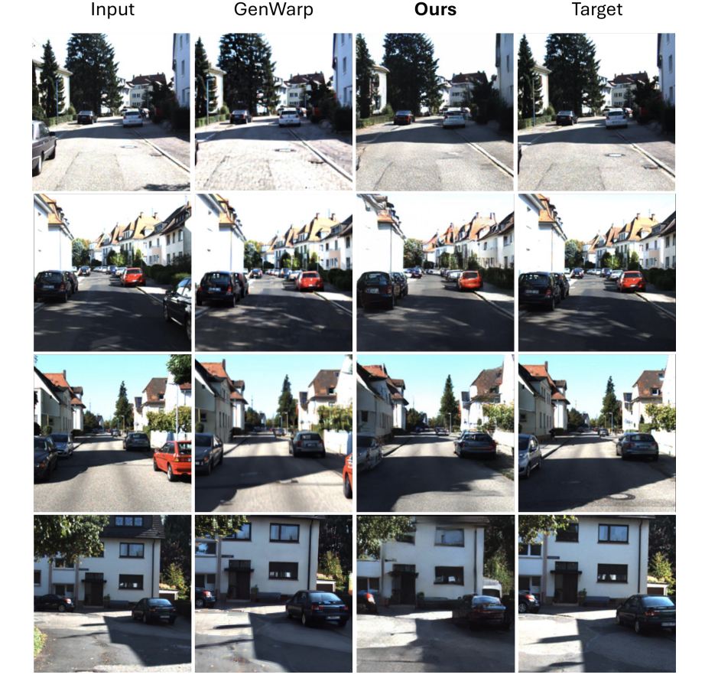
Qualitative Results
Seo, Junyoung, et al. "Genwarp: Single image to novel views with semantic-preserving generative warping." Advances in Neural Information Processing Systems 37 (2024): 80220-80243.

Slide 14
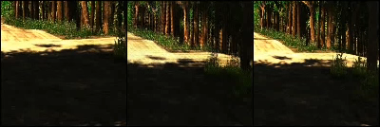
Qualitative Results
Source View
Novel View
GroundTruth

Slide 15
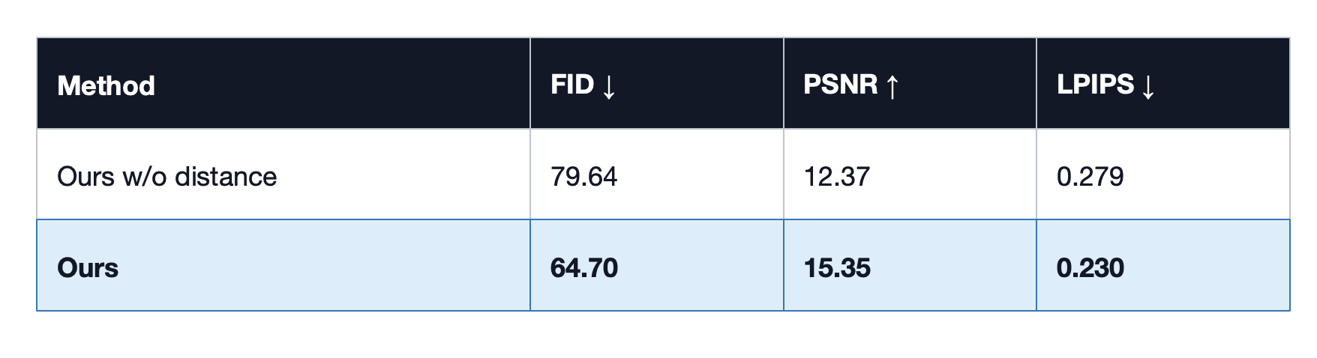
Camera distance is a consequential conditioning signal
KITTI ablation: removing camera distance degrades every reported metric.
Takeaway
The distance embedding helps the model estimate the magnitude of viewpoint change, not only its direction.

Slide 16
Conclusion
View Translation synthesizes geometry-consistent virtual camera views for ground vehicles by combining target-depth-guided warping with ControlNet-based latent diffusion.
The method preserves source appearance, uses relative pose and camera distance to model viewpoint change, and restores disoccluded regions beyond what geometric warping alone can provide.
The results support geometry-guided diffusion as a practical direction for expanding vehicle perception beyond installed camera viewpoints.
Future work targets higher resolution, better video consistency, online depth, and real-time inference.

